Slide 1
SG2000 PCB Layout Guide
Version: 0.2
Release date: 2022/09/13

Slide 2
Outline
Checklist
Stackup
DDR Power Supply Winding
Serdes Signal Winding - MIPI/USB/EPHY
Single-end Signal Winding - GPIO/SDIO - EMMC/AUD/XTAL/WIFI
Analog / Digital Power Supply Winding - VDDC -Analog IO Power Supply

Slide 3
SG2000 PCB Type
PCB is divided into the following PCB layouts according to the different PKG types supported : (1) QFN PKG: SG2002, DDR3/DDR2 SIP on PKG (4-Layer/6-Layer PCB) (2) BGA PKG: SG2000, DDR2/DDR3 SIP on PKG (4-Layer/6-Layer PCB)
Layout rule is divided into the following two parts: (1) DDR Layout rule (2 types) (2) Serdes/Single-end/Power Layout rule (common rule)
The PCB layout rules corresponding to the PKG type and stacked structure are as follows :
Type | Stackup | DDR Layout Rule | Serdes/Single-end/Power Layout rule
QFN PKG | (1) 4-layer PCB (2) 6-layer PCB (true 6 layers) | QFN power supply winding | 4-layer/6-layer (true 6 layers) PCB layout rule (common rule)
BGA PKG | (1) 4-layer PCB (2) 6-layer PCB (true 6 layers) | BGA power supply winding

Slide 4
Checklist

Slide 5
Checklist – Stackup – 4L-PCB/6L-PCB
No. | Rule | Description | Requirement | Check
1 | 4L-PCB Stacking requirements | Dielectric / Copper Thickness Limitations | 1. Confirm the thickness of the dielectric layer – pp/core (1) pp<=5mils (After Cu and pp are laminated together , the thickness of pp excluding the Cu) (2) L2/L3 Core thickness >=25mils, 2. Each layer of Cu Thickness 1oz.
2 | 6L-PCB Stacking requirements | Dielectric / Copper Thickness Limitations | 1. Confirm dielectric layer thickness – pp/core (1) L1/L2, L3/L4, L5/L6: pp<=5mils (After Cu and pp are laminated together , the thickness of pp excluding the Cu) (2) All core thickness >11mils 2. The thickness of each layer of Cu is 1oz.

Slide 6
Checklist - Layout Rule
No. | Rule | Description | Requirement | Check
1 | DDR routing | DDR3Q_1.5V rule | 1. Confirm QFN PKG E-pad solder mask coverage area (7.6x7.6mm²) with 3 vias 2. It is recommended to paste the DDR routing/VIA/Cap layout under the SOC PKG
2 | MIPI routing | Surface / Inner layer impedance control | Confirm polar results with PCB vendor : (1) Surface layer: Diff Coated Coplanar Strips with GND 1B (2) Inner layer: Diff Offset Coplanar Strips 1B1A
3 |  | Surface layer routing lane to lane NO GND shielding | Lane to lane NO GND shielding trace length <3.5mm
4 |  | BGA PKG, GND plane rule – ensure MIPI signal return path. | TX/RX reserves more than 3 channels on the GND plane below the SOC ball
5 |  | Length matching rule | Confirm TX/RX length matching
6 | USB | Surface / Inner layer impedance control | Confirm polar results with PCB vendor : (1) Surface layer: Diff Coated Coplanar Strips with GND 1B (2) Inner layer: Diff Offset Coplanar Strips 1B1A
7 |  | Length matching rule | P/N length matching
8 | EPHY routing | Surface / Inner layer impedance control | Confirm polar results with PCB vendor : (1) Surface layer: Diff Coated Coplanar Strips with GND 1B (2) Inner layer : Diff Offset Coplanar Strips 1B1A
9 |  | Length matching rule | P/N length matching

Slide 7
Checklist - Layout Rule
No. | Rule | Description | Requirement | Check
10 | Single-end rule | Surface / Inner layer shielding Rule | Shielding rule
11 | EMMC rule | Surface / Inner layer shielding Rule | Shielding rule
12 | AUD rule | Surface layer shielding rule | Shielding rule
13 | XTAL rule | Surface layer shielding rule | Shielding rule
14 | RTC rule | Surface layer shielding rule | Shielding rule
15 | WIFI_ANT rule | Surface layer impedance control | Confirm polar results with PCB vendor : (1) Surface layer : Coated Coplanar Strips with GND 1B
16 | VDC rule | 1. Confirm the number and location of Caps , the number of vias 2. Channel width | Rule1: (1) Number of vias at SOC/PMIC (2) VIA rules for VDDC/GND at the capacitor pins near the SOC 2. Channel width refers to rule2 3. It is recommended to paste the VDDC trace/VIA/Cap layout under the SOC PKG
17 | Analog IO Power rule | 1. Trace width rule 2. Confirm the number and location of Caps and the number of vias | Rule1: (1) Number of vias at SOC/PMIC (2) VIA rules for power/GND at the capacitor pins near the SOC 2. Channel width refers to rule2 3. It is recommended to attach the power trace/VIA/Cap layout under the SOC PKG

Slide 8
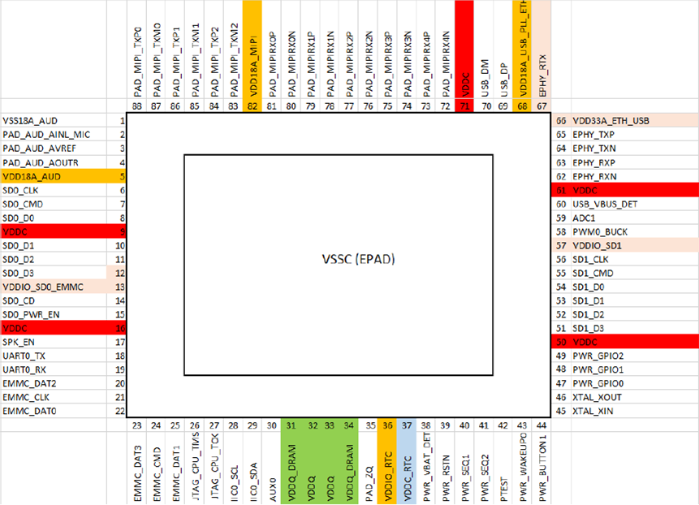
QFN Ball Map
MIPI
USB
EPHY
AUD
SDIO
SDIO
EMMC
DDR

Slide 9
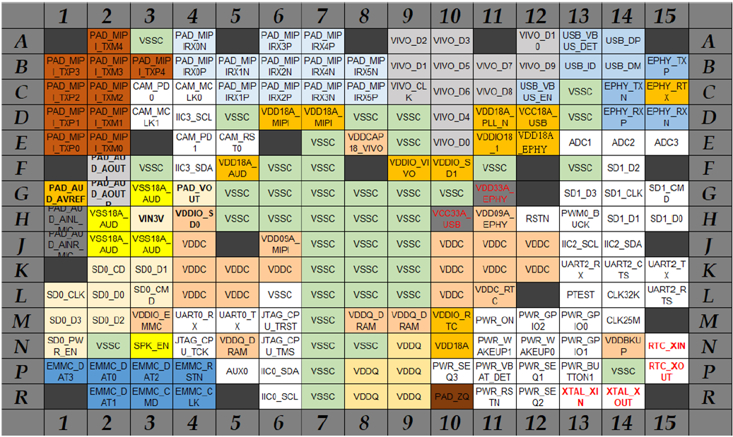
BGA Ball Map
MIPI
USB
EPHY
AUD
SDIO
SDIO
EMMC
DDR

Slide 10
Stackup
QFN/BGA PKG: SG200X
4-layer/6-layer PCB

Slide 11
PCB 4-Layer Stackup
Number of stacked layers : 4 layers
Stack thickness : 1mm +/-10% <= thickness <=1.6mm +/-10%
Each layer of Cu uses 1oz.
Dielectric layer thickness limit :
Reference Stack
Layer Number | Material | Thickness Limit
L1/L2 | Prepreg | <=5mils (After Cu and pp are laminated together , the thickness of pp excluding the Cu)
L3/L4
L2/L3 | Core | >=25mils

Slide 12
PCB 6-Layer Stackup
Number of stacked layers : 6 layers
Stack thickness : 1.2mm +/-10% <= thickness <=1.6mm +/-10%
Each layer of Cu uses 1oz .
Dielectric layer thickness limit :
Reference Stack
Layer Number | Material | Thickness Limit
L1/L2 | Prepreg | <=5mils (After Cu and pp are laminated together , the thickness of pp excluding the Cu)
L5/L6
L3/L4
L2/L3 | Core | >=11mils
L4/L5

Slide 13
DDR Power Supply Winding (DDR3_1.5V)
QFN PKG: SG2002
4-layer/6-layer PCB

Slide 14
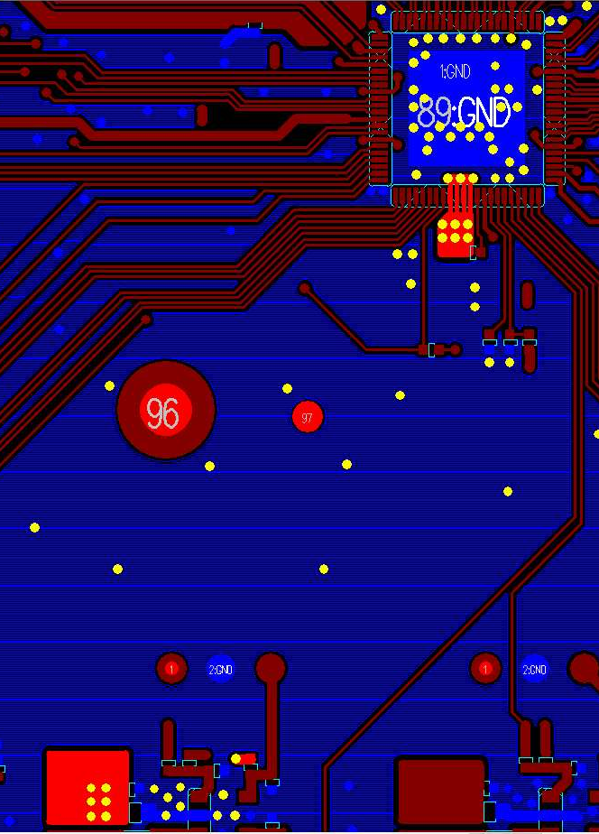
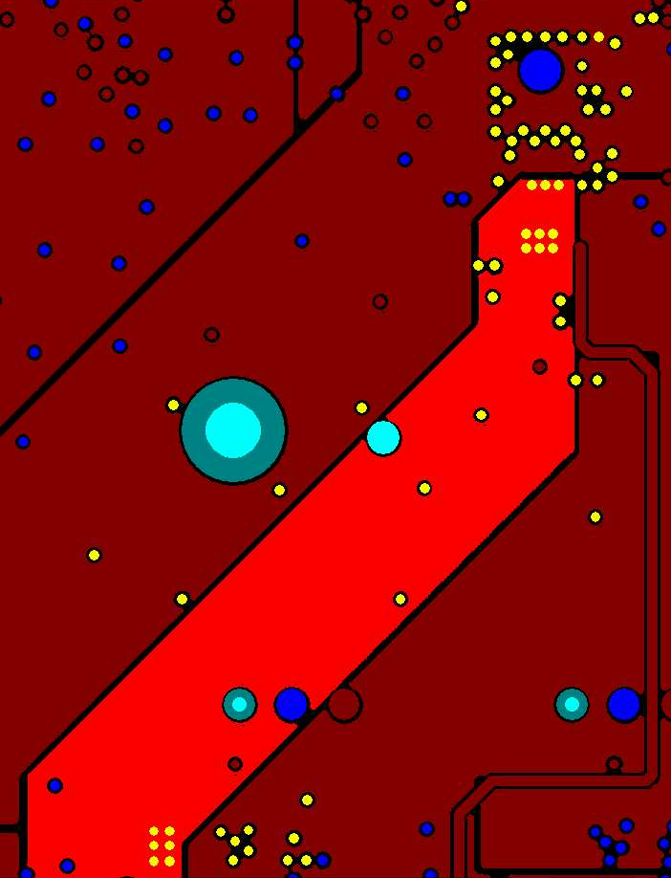
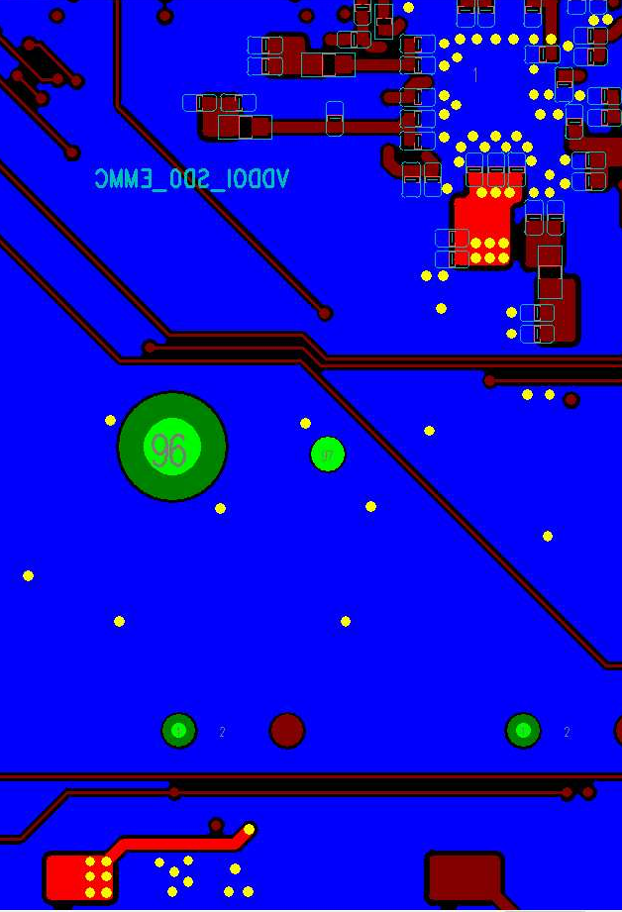
QFN - 4L/6L-PCB DDR Layout
Stackup: (1) 4L-PCB: GND@L1/L2/L4 (plane), 6L-PCB: GND@L1/L2/L3/L4/L6 (plane) (2) 4L-PCB: DDR3_1.5V@L3 (shape), 6L-PCB: DDR3_1.5V@L4 (shape)
4-Layers Stackup
L1 GND
4L-PCB: DDR3_1.5V@L3
6L-PCB: DDR3_1.5V@L4
pp
DDR3_1.5V@Top
DDR3_1.5V@Bottom
L2 : GND
SOC
Core
pp
L3 : DDR3_1.5V
L4 : GND
6-layers Stackup
L1 GND
pp
L2 : GND
Core
L3 : GND
pp
L4 : DDR3_1.5V
Core
PMIC
pp
L5 : GND
L6 : GND

Slide 15
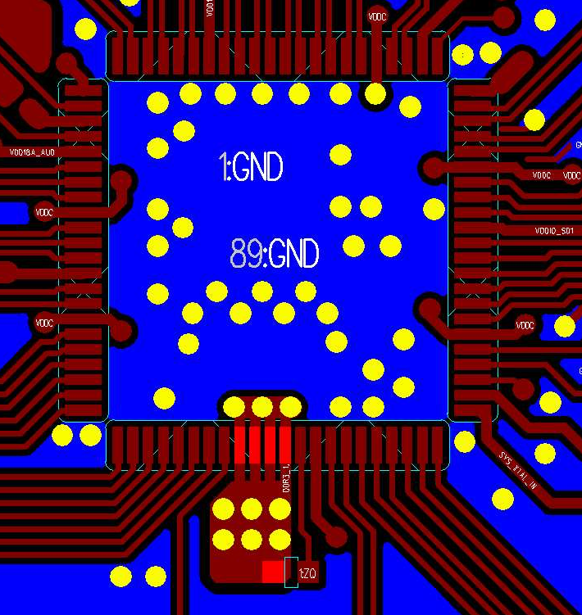
QFN - 4L/6L-PCB - DDR3_1.5V - Rule 1
Power | Layer | SOC VIA count | Layout rule
DDR3_1.5V | Top | (1) @E-pad 7.6x7.6mm² area : VIA quantity : 3 (2) pin out area: VIA quantity : 6 | (1) Cover Solder mask area: E-pad 7.6x7.6mm² (2) Non-covered Solder mask area: E-pad 6x6mm² (3) Confirm the number of vias on the DDR3_1.5V SOC side
DDR3_1.5V@Top
E-pad aera 7.6x7.6mm² (soder mask)
SOC
E-pad aera 6x6mm² (uncover solder mask)
pin out area

Slide 16
QFN - 4L/6L-PCB – DDR3_1.5V - Rule 2
Power | Layer | Layout rule
DDR3_1.5V | 4L-PCB: DDR3_1.5V@L3 6L-PCB: DDR3_1.5V@L4 | DDR3_1.5V main route, (1) Confirm that there are 6 vias each at the SOC and PMIC (2) Deduct the effective width of the vias: W1>=1.5mm, W2>=1.5mm
DDR3_1.5V@Top
4L-PCB: DDR3_1.5V@L3
6L-PCB: DDR3_1.5V@L4
SOC
SOC area VIA
W2
W1
PMIC
PMIC area VIA

Slide 17
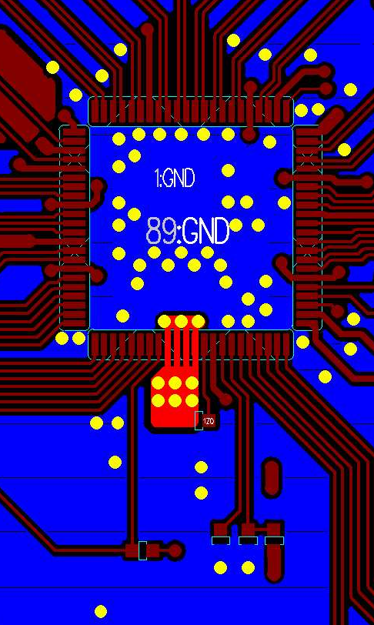
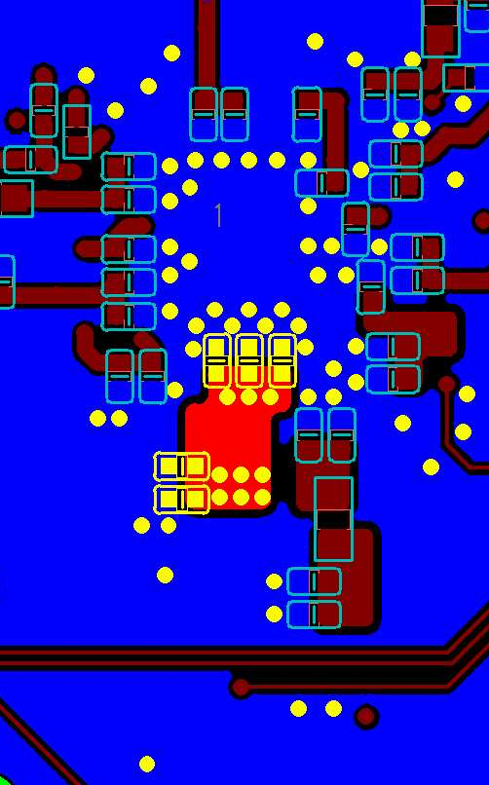
QFN - 4L/6L-PCB - DDR3Q_1.5V - Rule 3
Power | Layer | DeCap@Dram Area | Layout Rule
DDR3Q_1.5V | Top/Bottom | DDR3Q_1.5V@Bottom: (1) 0402 0.1uF: C1/C2 (2) 0402 1uF: C3/C4 (3) 0402 4.7uF: C1 | (1) DDR3_1.5V VIA rule The 3 vias in the E-pad area are closely connected to C1/C2/C3 The 6 vias in the pin-out area are closely connected to C4/C5 (1) GND VIA rule Confirm that there is at least 1 GND via next to each Cap
DDR3_1.5V@Top
DDR3_1.5V@Bottom
C1
C2
C3
E-pad area:3 vias
C4
Pin-out area:6 vias
C5

Slide 18
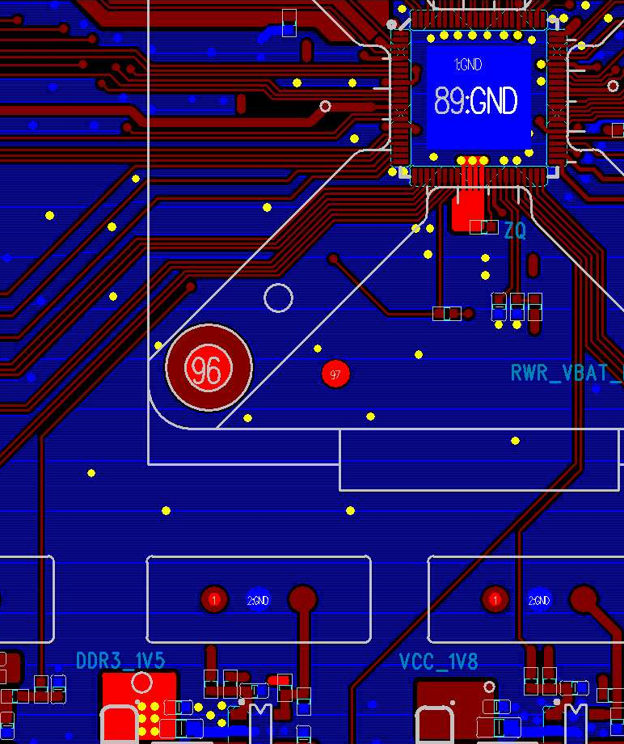
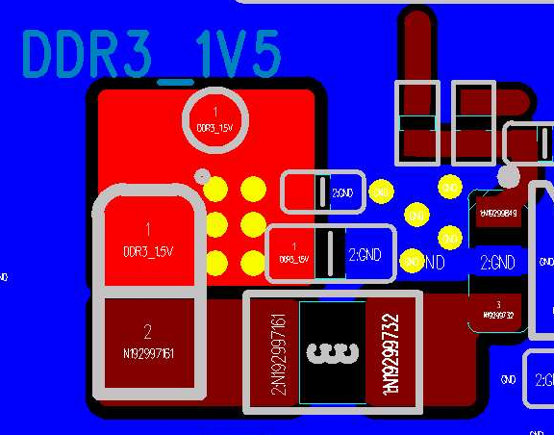
QFN - 4L/6L-PCB - DDR3_1.5V - Rule 4
Power | PMIC Branch Node VIA Quantity
DDR3_1.5V | (1) DDR3_1.5V: VIA quantity >=6 (2) GND: VIA quantity >=5
DDR3_1.5V@Top
PMIC routing area
PMIC Branch Node VIA Quantity
DDR3_1.5V:
VIA quantity: 6
GND:
VIA quantity: 5
PMIC

Slide 19
DDR Power Supply Winding (DDR3_1.5V)
BGA PKG: SG2000
4-layer/6-layer PCB

Slide 20
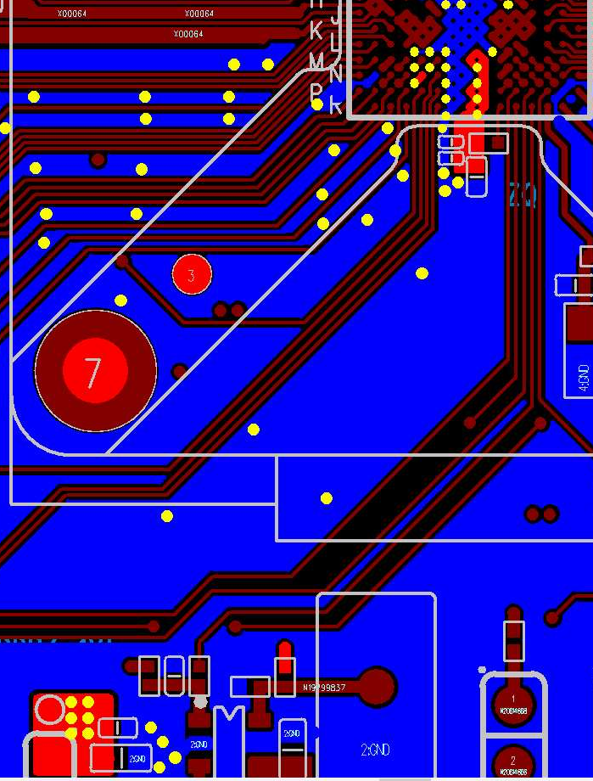
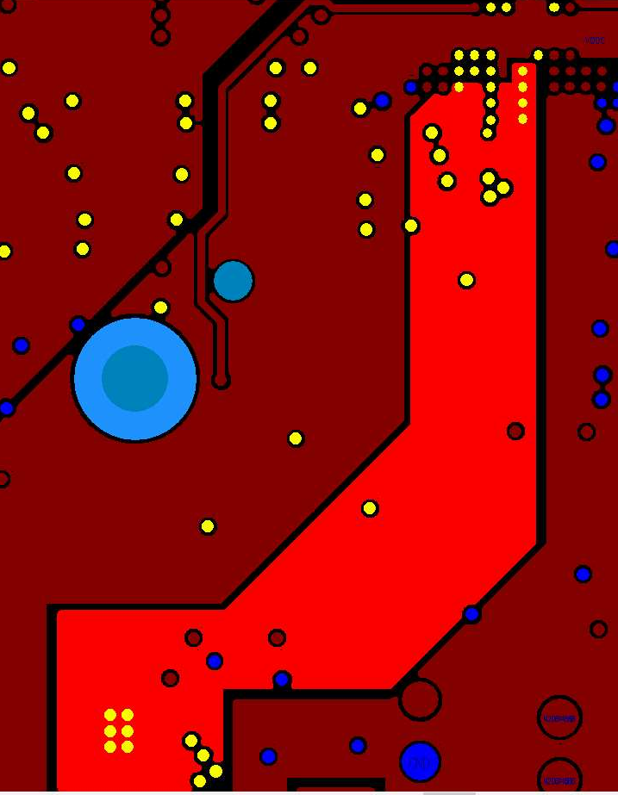
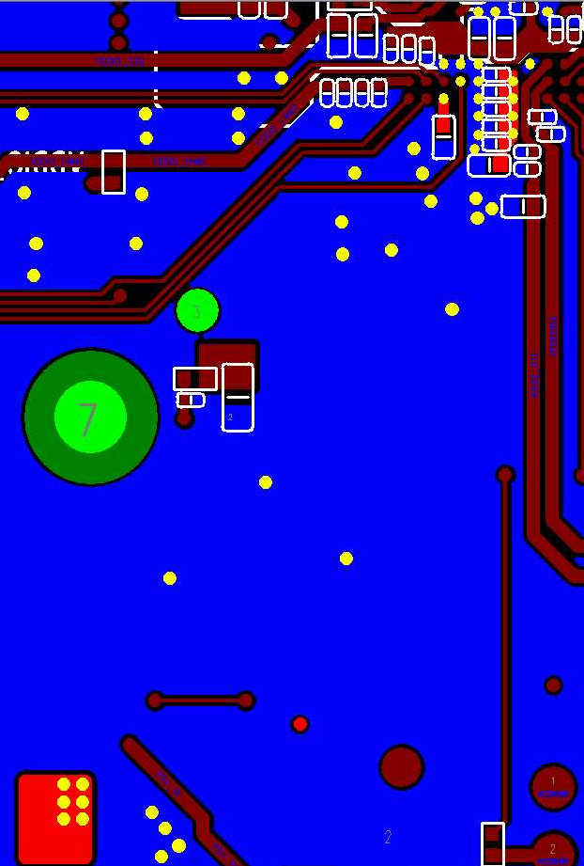
BGA – 4L/6L-PCB DDR Layout
Stackup: (1) 4L-PCB: GND@L1/L2/L4 (plane), 6L-PCB: GND@L1/L2/L3/L4/L6 (plane) (2) 4L-PCB: DDR3_1.5V@L3 (shape), 6L-PCB: DDR3_1.5V@L4 (shape)
4-Layers Stackup
L1 GND
4L-PCB: DDR3_1.5V@L3
6L-PCB: DDR3_1.5V@L4
pp
DDR3_1.5V@Top
DDR3_1.5V@Bottom
L2 : GND
SOC
Core
pp
L3 : DDR3_1.5V
L4 : GND
6-layers Stackup
L1 GND
pp
L2 : GND
Core
L3 : GND
pp
L4 : DDR3_1.5V
Core
PMIC
pp
L5 : GND
L6 : GND

Slide 21
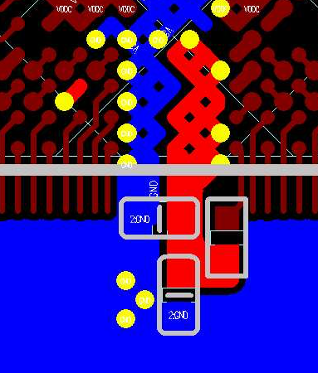
BGA – 4L/6L-PCB - DDR3_1.5V - Rule 1
Power | Layer | SOC VIA Count | Layout Rule
DDR3_1.5V | Top | (1) DDR3_1.5V (ball N5): 1 (2) DDR3_1.5V (merge ball): 4 | Confirm the number of vias on the DDR3_1.5V SOC side Ball N5 VIA: Connect bottom Cap Merge ball VIA: Connect inner layer main route trace
DDR3_1.5V@Top
DDR3_1.5V (merge ball)
DDR3_1.5V (ball N5)

Slide 22
BGA – 4L/6L-PCB - DDR3_1.5V - Rule 2
Power | Layer | Layout Rule
DDR3_1.5V | 4L-PCB: DDR3_1.5V@L3 6L-PCB: DDR3_1.5V@L4 | DDR3_1.5V main route: (1) Confirm that there are 4 vias at the SOC and >=5 vias at the PMIC (2) ) Deduct the effective width of vias: W1>=1.5mm, W2>=1.5mm
4L-PCB: DDR3_1.5V@L3
6L-PCB: DDR3_1.5V@L4
DDR3_1.5V@Top
SOC
SOC
SOC area VIA
W2
W1
PMIC
PMIC area VIA

Slide 23
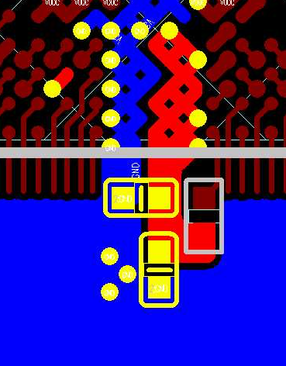
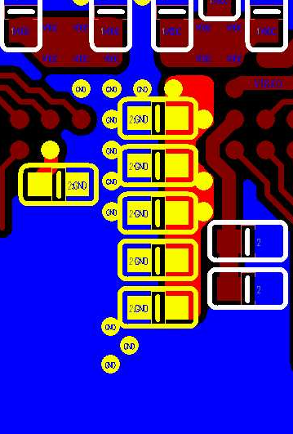
BGA – 4L/6L-PCB - DDR3Q_1.5V - Rule 3
Power | Layer | DeCap@Dram Area | Layout Rule
DDR3Q_1.5V | Top/Bottom | DDR3Q_1.5V@Top: (1) 0402 1uF: C1/C2 DDR3Q_1.5V@Bottom: (1) 0402 0.1uF: C4/C5 (2) 0402 1uF: C3/C7/C6 (3) 0402 4.7uF: C8 | (1) DDR3_1.5V VIA rule Make sure there is at least 1 DDR3_1.5V via next to each Cap (2) GND VIA rule Make sure there is at least 1 GND next to each Cap via
DDR3_1.5V@Top
DDR3_1.5V@Bottom
DDR3_1.5V (ball N5)
DDR3_1.5V (merge ball)
C4
C5
C3
C6
C1
C7
C2
C8

Slide 24
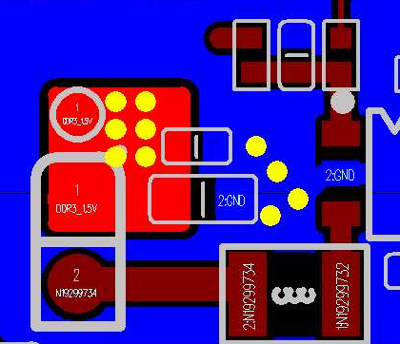

BGA – 4L/6L-PCB - DDR3_1.5V - Rule 4
Power | PMIC Branch Node VIA Quantity
DDR3_1.5V | (1) DDR3_1.5V: VIA quantity >=6 (2) GND: VIA quantity >=5
DDR3_1.5V@Top
PMIC routing area
PMIC 分支点 VIA 数量
DDR3_1.5V:
VIA 数量6
GND:
VIA 数量5
PMIC

Slide 25
Serdes Signal Winding
QFN/BGA PKG: SG200X
4-layer/6-layer PCB

Slide 26
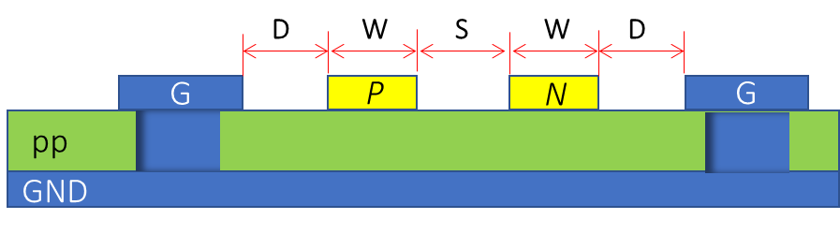
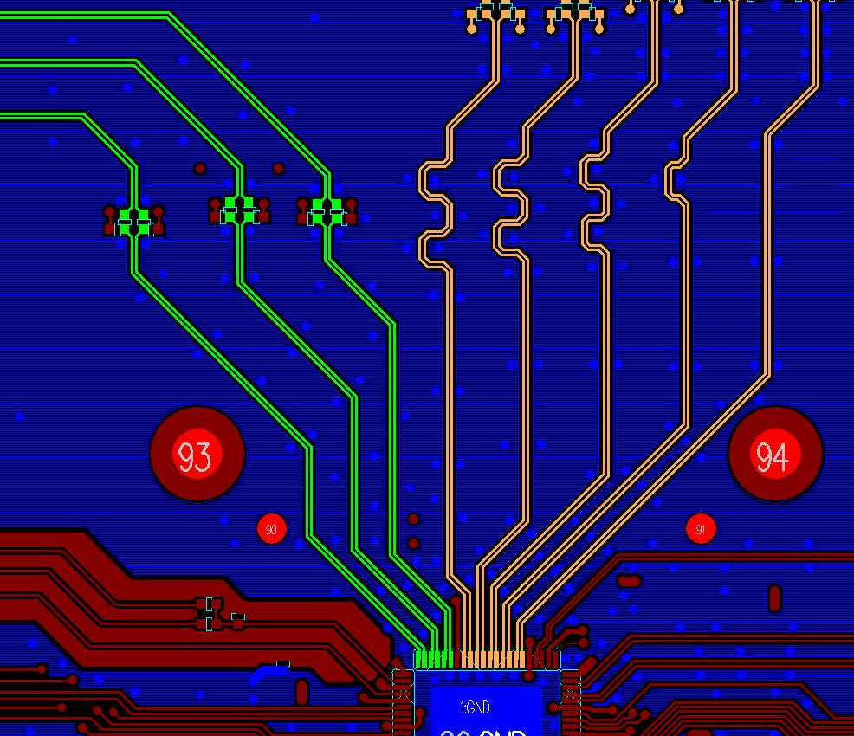
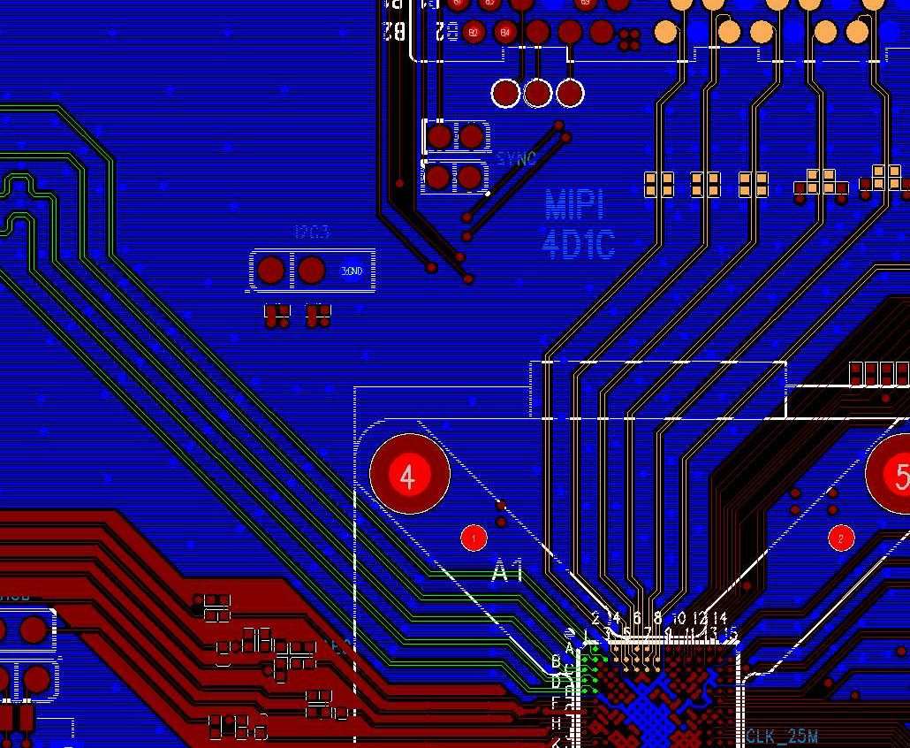
QFN/BGA – 4L/6L-PCB- MIPI Routing – Surface Layer Routing
Option1 Rule 1
MIPI TX/RX
Signal | Layer | Zo | Trace Width/Spacing (mm) | Shielding Rule
MIPI_TX/RX Diff pair | Top/ Bottom | 100 ohm | 0.125/0.125/0.15 (W/S/D) | Lane to Lane GND shielding
QFN MIPI TX/RX differential signals layout@Top
BGA MIPI TX/RX differential signals layout@Top
MIPI_TX
MIPI_RX
MIPI_TX
MIPI_RX
SOC
SOC

Slide 27
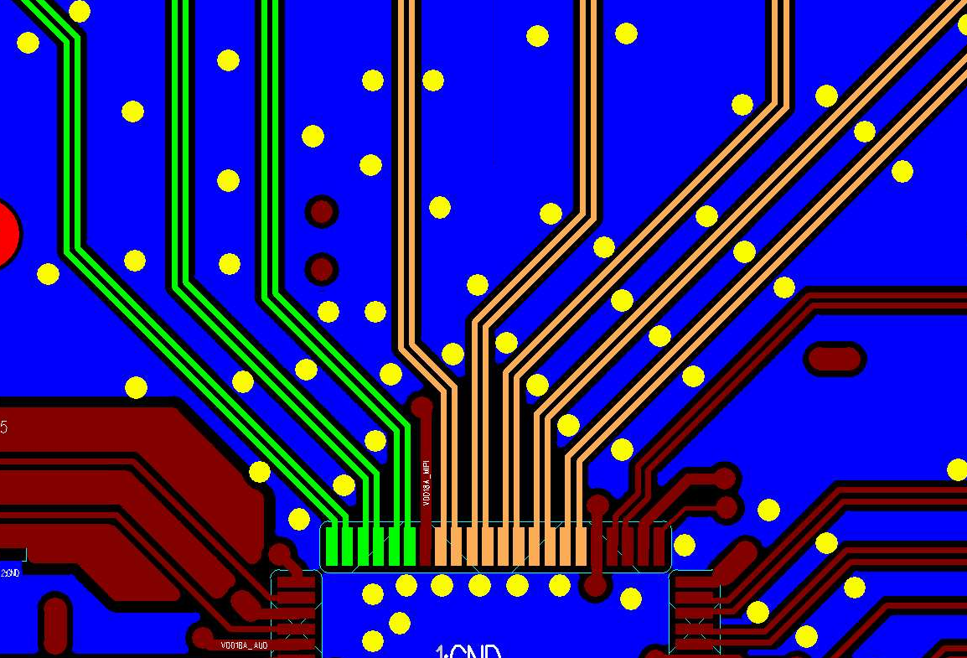
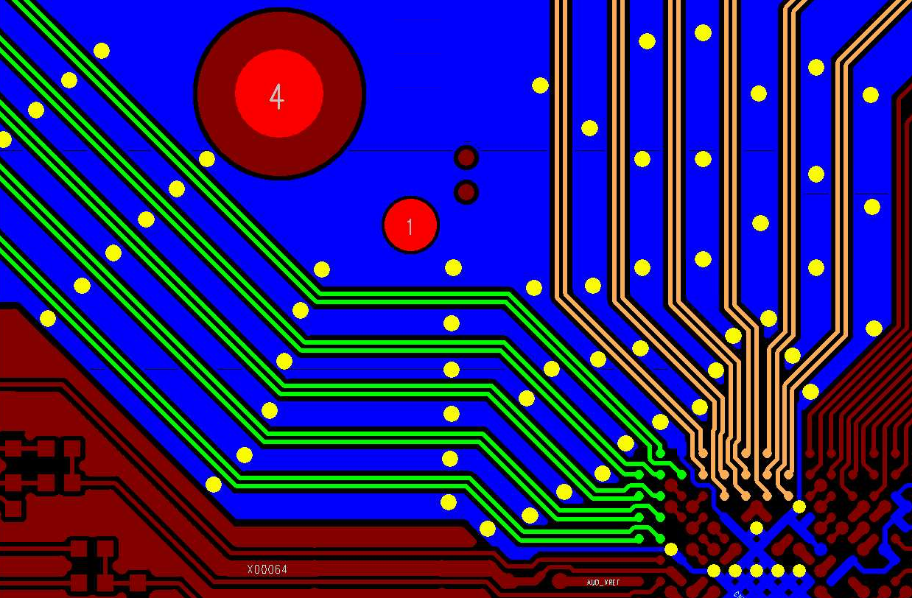
QFN/BGA – 4L/6L-PCB – MIPI Routing – Surface Layer Routing Option1 - Rule 2
Signal | Layer | Requirement | Layout Rule
MIPI_TX/RX Diff pair | Top/ Bottom | Lane to lane shielding GND VIA distance | L1 (GND stitching VIA) < 7.5mm NO GND shielding length L2 < 3.5mm
QFN MIPI TX/RX shielding GND VIA distance@Top
BGA MIPI TX/RX shielding GND VIA distance@Top
L1
L1
L2
L2
SOC
SOC

Slide 28
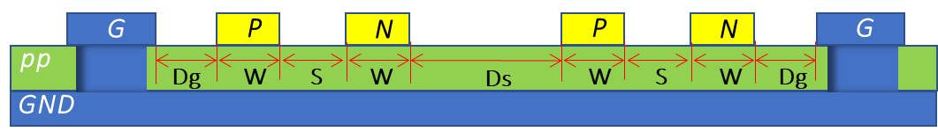
QFN/BGA – 4L/6L-PCB – MIPI Routing – Surface Layer Routing Option2 - Rule
Signal | Layer | Zo | Trace Width/Spacing (mm) | Shielding Rule
MIPI_TX/RX Diff pair | Top/ Bottom | 100ohm | 0.125/0.125/0.3/0.3 (W/S/Ds/Dg) | (1) Lane to Lane NO GND shielding, confirm that the GND plane under the diff is intact (2) TX/RX Group GND shielding, GND shielding must go under VIA: VIA to VIA distance<7.5mm (3) Lane to lane distance restrictions : 1) Winding length>=10mm, Ds=3W, Dg=3W (It allows Dg=2W) 2) Winding length<10mm, Ds>=2W, Dg>=2W
MIPI TX
MIPI RX

Slide 29
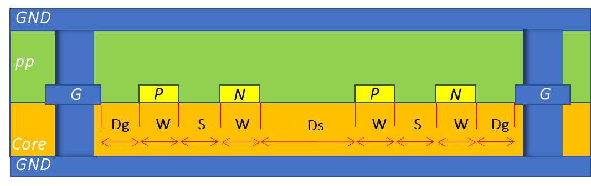
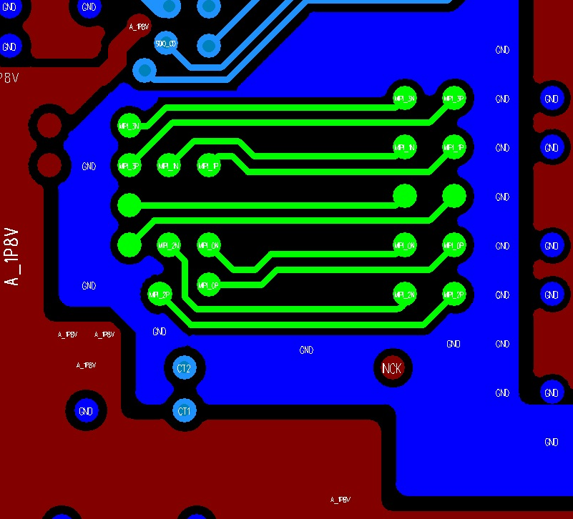
QFN/BGA – 4L/6L-PCB – MIPI W Routing – Inner Layer Routing - Rule
Signal | Layer | Zo (ohm) | Trace Width/Spacing (mm) (W/S/Ds/Dg) | Shielding Rule
MIPI_TX/RX Diff pair | 4L-PCB: L2 6L-PCB: L3 | 100 | 4L-PCB: 0.125/0.25/0.3/0.3 6L-PCB: 0.125/0.25/0.3/0.3 | (1) Lane to Lane NO GND shielding, confirm that the GND plane under the diff is intact (2) TX/RX Group GND shielding, GND shielding must go under VIA: VIA to VIA distance<7.5mm (3) Lane to lane distance restrictions: 1) Winding length>=10mm, Ds=3W, Dg=3W (It allows Dg=2W) 2)Winding length<10mm, Ds>=2W, Dg>=2W
MIPI TX
RX@Inner, Option2, RX group GND shielding
GND
SOC
MIPI_RX
MIPI RX
GND

Slide 30
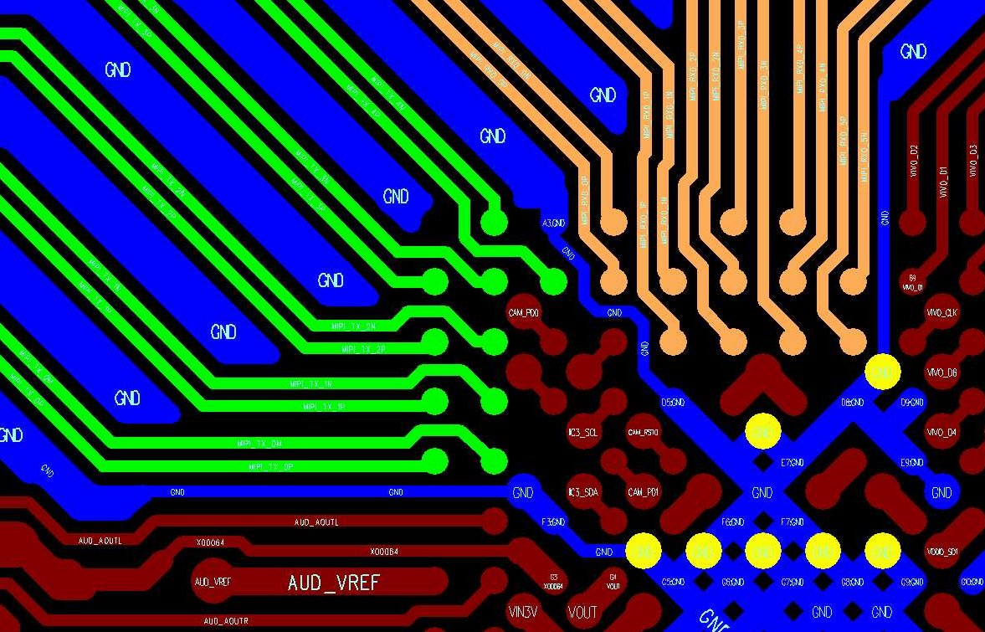
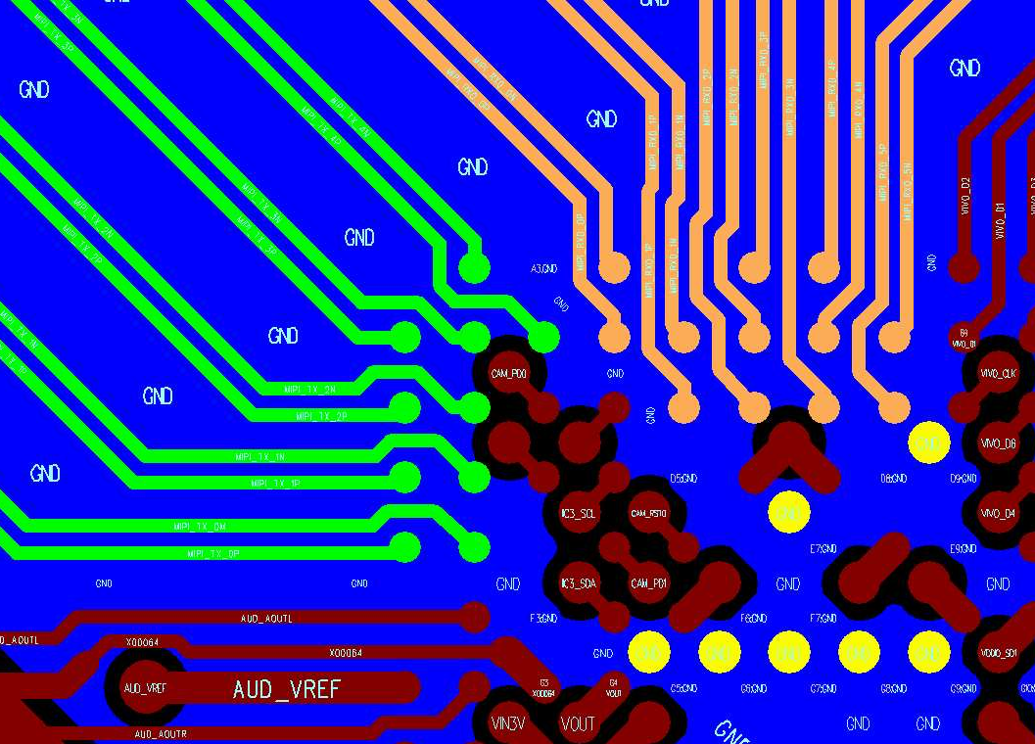
BGA – 4L/6L-PCB – MIPI Routing – GND Plane Rule
Signal | Layer | Layout Rule
TX/RX GND plane | L2 | Confirm that the vias in the GND plane@L2 below the TX/RX@SOC will retain more than 3 sets of channels. Please refer to the picture below for Layer2 GND plane )
MIPI TX/RX@Top
MIPI TX/RX@Top + GND plane@L2
DQ/CA@L1
MIPI_RX
GND plane retain more than 3 sets of channels
MIPI_TX
3
2
SOC
1
GND VIA

Slide 31
MIPI Routing – Length Matching Rule
Signal | Matching Reference | Matching Length
TX | inter skew | <=2.5mm (100mils)
RX | inter skew
TX | P/N intra skew | <=0.5mm (20mils)
RX | P/N intra skew

Slide 32
QFN/BGA – 4L/6L-PCB – USB Routing – Surface Layer Routing - Rule
Signal | Layer | Zo | Trace Width/Spacing (mm) | Shielding Rule
USB Diff pair | Top/ Bottom | 90ohm | 0.125/0.1/0.15 (W/S/D) | Lane to lane GND shielding. Shielding GND VIA: Lane to Lane GND shielding must go under with VIA (VIA to VIA distance<=7.5mm)
USB Diff pair
D
W
S
W
D
Shielding GND VIA
GND
G
P
N
G
S1
Diff P/N
pp
GND
GND

Slide 33
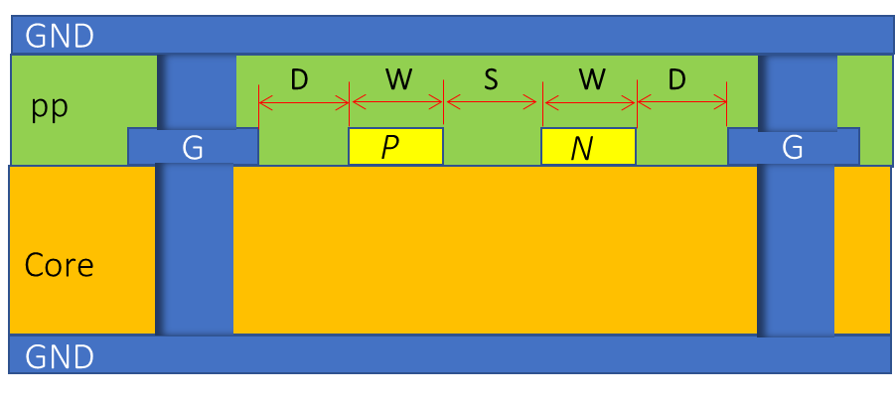
QFN/BGA – 4L/6L-PCB – USB Routing – Inner Layer Routing - Rule
Signal | Layer | Zo | Trace Width/Spacing (mm) | Shielding Rule
USB Diff pair | 4L-PCB: L2 6L-PCB: L3 | 90ohm | 4L-PCB: 0.125/0.175/0.15 (W/S/D) 6L-PCB: 0.125/0.175/0.15 (W/S/D) | Lane to lane GND shielding. Shielding GND VIA: Lane to Lane GND shielding must go under with VIA (VIA to VIA distance S1<=7.5mm)
USB Diff pair
Shielding GND VIA
GND
S1
Diff P/N
GND

Slide 34
USB Routing – Length Matching Rule
Signal | Matching Reference | Matching Length
USB_DM USB_DP | P/N intra skew | <=0.5mm (20mils)

Slide 35
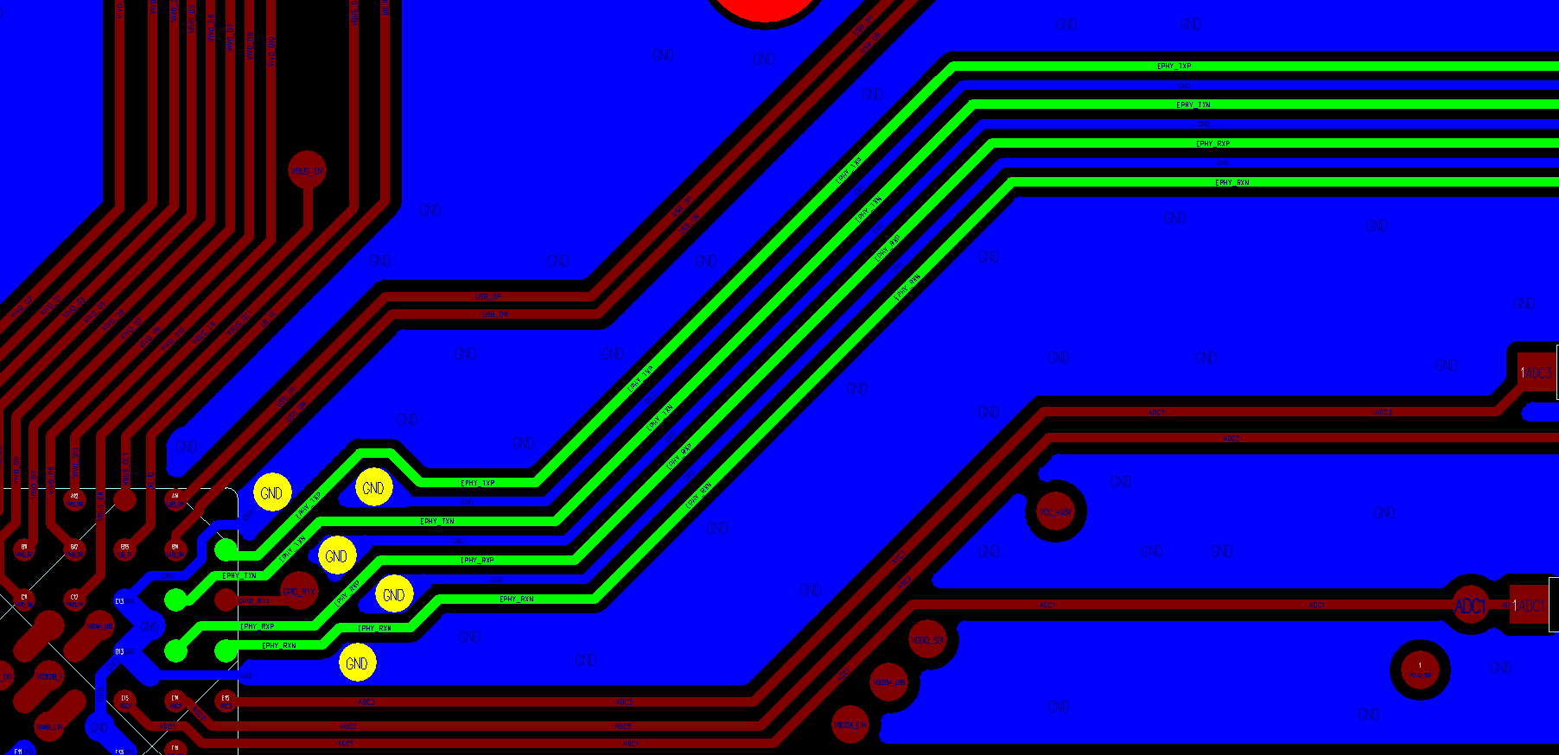
QFN/BGA – 4L/6L-PCB - EPHY Routing – Surface Layer Routing - Rule1
Signal | Layer | Zo | Trace Width/Spacing (mm) | Shielding Rule
EPHY TX/RX Diff pair | Top | No control | 0.125/0.125/0.125 (Ws/Sg/Wg) | Between P/N, there must be GND trace shielding Between TX/RX, there must be GND trace shielding GND trace VIA rule: 1) It is required to confirm that the GND trace near the SOC end has at least one VIA forming a loop with the SOC PKG GND. 2) It is required to confirm that the GND trace near the transformer end has at least one VIA forming a loop with the transformer GND pin.
Shielding GND VIA
EPHY TX/RX
Wg
Sg
Ws
Sg
Wg
Sg
Ws
Sg
Wg
G
P
G
N
G
G
Core
SOC
GND
GND reflow VIA

Slide 36
QFN/BGA – 4L/6L-PCB - EPHY Routing – Surface Layer Routing - Rule2
Signal | Layer | Requirement | Layout Rule
EPHY TX/RX | Top | TX to RX GND shielding 0.125/0.125 (Wg/Sg) | GND trace VIA rule: 1) It is required to confirm that the GND trace near the SOC end has at least one VIA forming a loop with the SOC PKG E-pad. 2)It is required to confirm that the GND trace near the transformer end has at least one VIA forming a loop with the transformer GND pin.
EPHY TX/RX Isolation
TX
Sg
Wg
Sg
RX
G
P
G
N
G
P
G
N
G
Core
GND

Slide 37
EPHY Routing – Length Matching Rule
Signal | Matching Reference | Matching Length
EPHY TX/RX Diff pair | P/N intra skew | <=0.5mm (20mils)

Slide 38
Single-end Signal Winding
QFN/BGA PKG: SG200X
4-layer/6-layer PCB

Slide 39
QFN/BGA – 4L/6L-PCB - Single-end – Rule
Signal | Layer | Shielding Rule | Trace Width/Spacing (mm)
SDIO RTC | 4L-PCB: Top/Bottom/L3 6L-PCB: Top/Bottom/L3 | Break out (fan-out) region: NO GND trace shielding, ref GND plane | W>=0.1 0.1/0.1 (S/D) (0.1mm spacing)
 |  | Main rout: NO GND trace shielding, ref GND plane | W>=0.1 0.15/0.1 (S/D) (0.15mm spacing)
NO GND trace shielding
G
S
S
S
…
S
G
pp
D
W
S
W
S
W
W
D
GND

Slide 40
QFN/BGA - 4L/6L-PCB– EMMC – Rule
Signal | Layer | Shielding Rule | Trace Width/Spacing (mm)
EMMC D0~D3 | Top | Break out (fan-out) region: NO GND trace shielding, ref GND plane | (1) W>=0.1 (2) 0.1/0.1 (S/D) (0.1mm spacing)
 |  | Main rout: NO GND trace shielding, ref GND plane | W>=0.1 0.15/0.1 (S/D) (0.15mm spacing)
Signal | Layer | Shielding Rule | Trace Width/Spacing (mm)
EMMC_CLK EMMC_CMD EMMC_RST_N (BGA) | 4L-PCB: Top/Bottom/L3 6L-PCB: Top/Bottom/L3 | Break out (fan-out) region: NO GND trace shielding, ref GND plane | (1) W>=0.1 (2) 0.1/0.1 (S/D)
 |  | per trace shielding, ref GND plane | (1) W>=0.1 (2) D=0.1
NO GND trace shielding
…
Per trace shielding
G
S
S
S
S
G
G
S
G
pp
D
W
S
W
S
W
W
D
pp
D
W
D
GND
GND

Slide 41
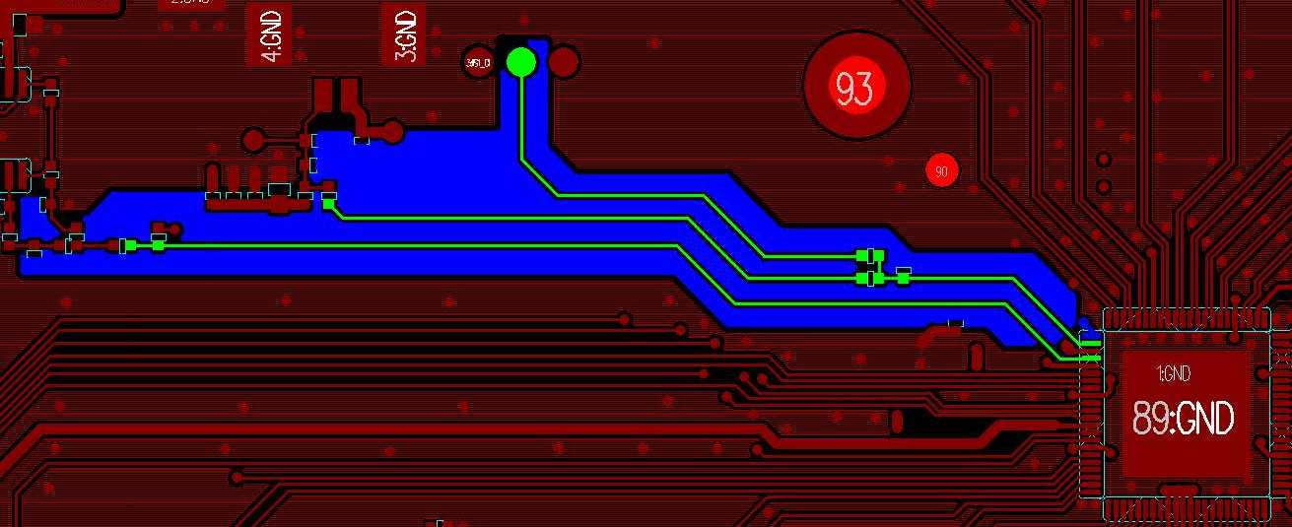
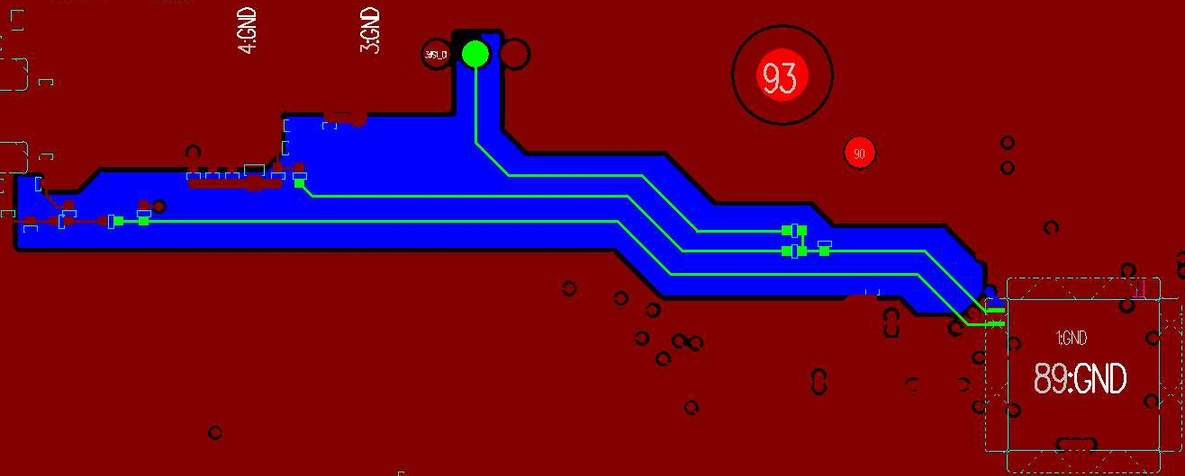
QFN 4L/6L-PCB – AUD – Rule
Signal | Layer | Shielding Rule | Trace Width/Spacing (mm)
AUD_MIC_L AUD_MIC AUD_OUT | Top | (1) per trace shielding (2) ref AUD GND plane (3) Confirm that there is a complete AUD GND plane beneath the AUD signal line | W>=0.1 D=0.1
Per trace shielding
G
S
G
pp
D
W
D
AUD GND
AUD@Top
AUD@L1/L2
AUD GND
AUD GND
AUD GND
pin

Slide 42
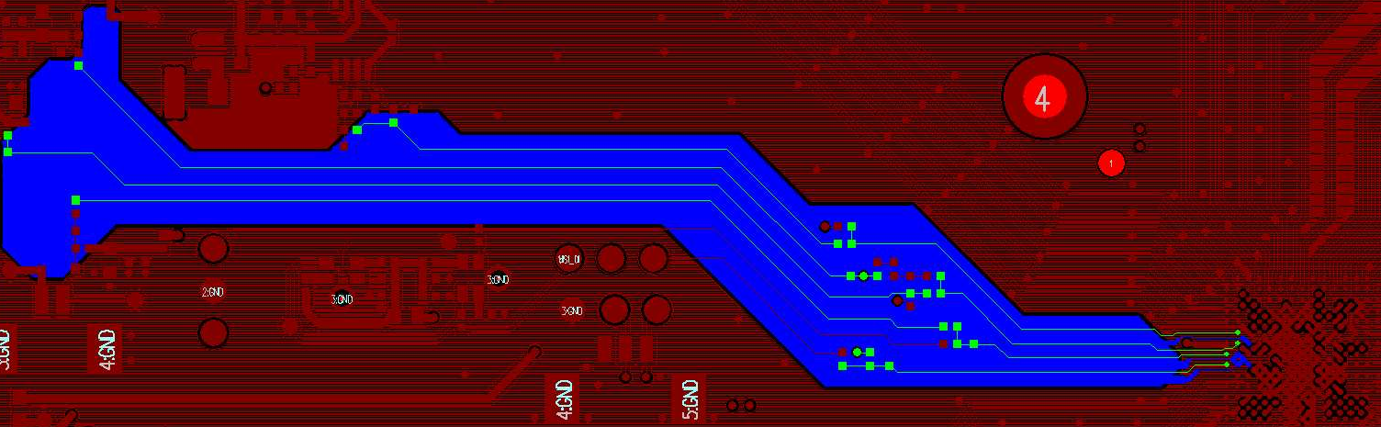
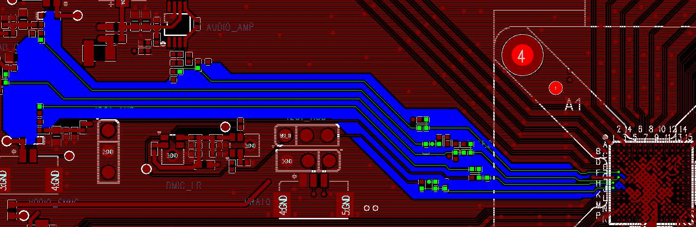
BGA – 4L/6L-PCB – AUD – Rule
Signal | Layer | Shielding Rule | Trace Width/Spacing (mm)
AUD_MIC_L/AUD_MIC_R AUD_MICL/AUD_MICR AUD_AOUTL/AUD_AOUR AC_AOUTL/AC_AOUR | Top | (1) per trace shielding (2) ref AUD GND plane (3) Confirm that there is a complete AUD GND plane beneath the AUD signal line | W>=0.1 D=0.1
Per trace shielding
G
S
G
pp
D
W
D
AUD GND
AUD@Top
AUD@L1/L2
AUD GND
AUD GND
AUD GND ball

Slide 43
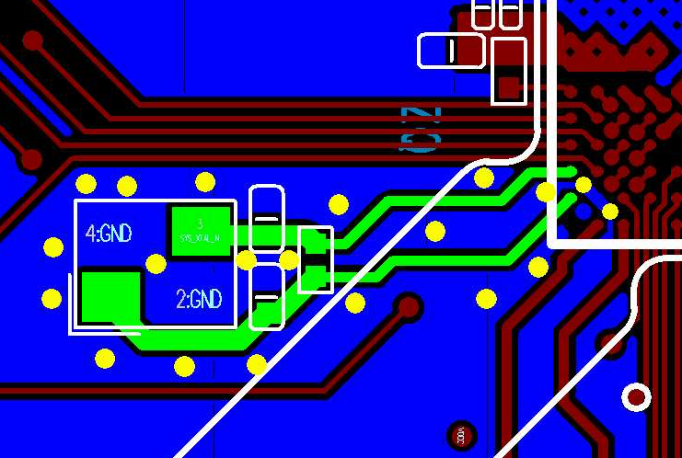
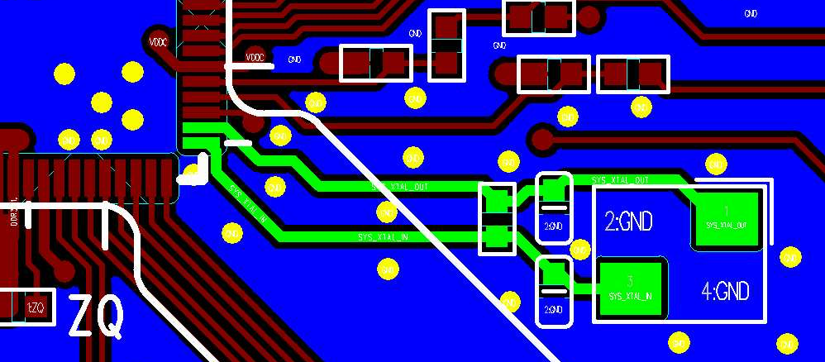
QFN/BGA – 4L/6L-PCB – XTAL_IN/OUT - Rule
Signal | Layer | Shielding Rule | Trace Width/Spacing (mm)
SYS_XTAL_IN SYS_XTAL_OUT | Top | per trace shielding ref GND plane | 0.25/0.25 (W/D)
Per trace shielding
G
S
G
pp
D
W
D
GND
QFN XTAL@Top
BGA XTAL@Top
XTAL_IN
XTAL IC
XTAL_OUT

Slide 44
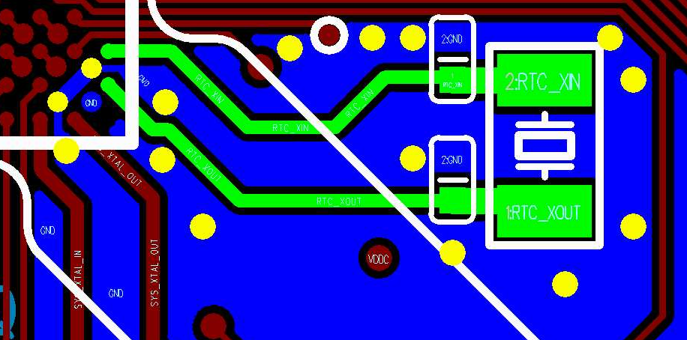
BGA only – 4L/6L-PCB – RTC_XIN/XOUT - Rule
Signal | Layer | Shielding Rule | Trace Width/Spacing (mm)
RTC_IN RTC_OUT | Top | Capacitor to XTAL: per trace shielding | 0.25/0.1 (W/D)
XTAL@L1
SOC
XTAL
Per trace shielding
G
S
G
RTC_XIN
pp
D
W
D
GND
RTC_XOUT
Two trace shielding
G
S
S
G
pp
D
W
S
W
D
GND

Slide 45
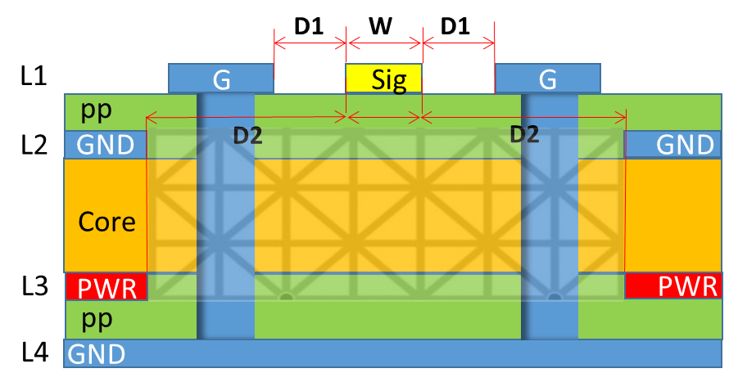
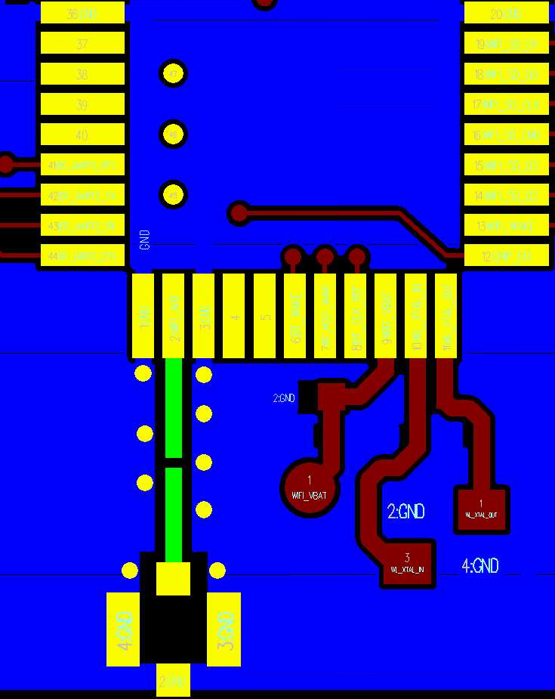
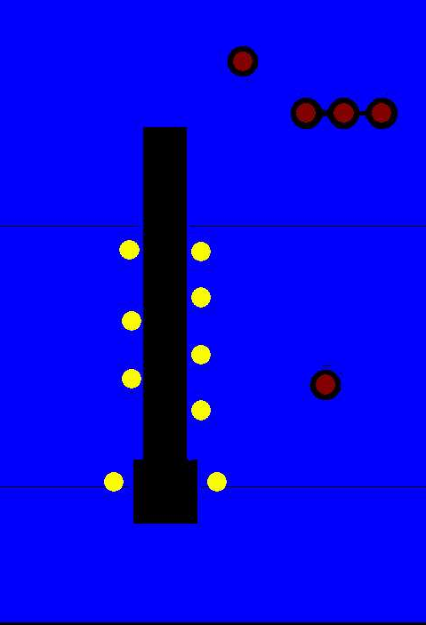
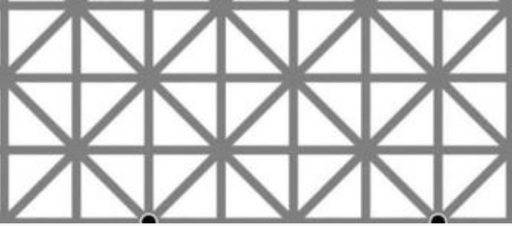
QFN/BGA – 4L/6L-PCB – WIFI_ANT Layout Rule
Signal | Layer | Zo | Shielding Rule | Trace Width/Spacing (mm)
WIFI_ANT | Top | 50ohm | Per trace shielding | 0.75/0.15/0.3 (W/D1/D2)
4L-PCB
WIFI_ANT@Top
WIFI_ANT@GND/PWR plane
Underneath the WIFI_ANT
a plane needs to be cleared
6L PCB
D1
W
D1
L1
G
Sig
G
pp
D2
D2
L2
GND
GND
WIFI_ANT
Core
L3
GND
GND
pp
PWR
PWR
L4
GND
Core
L5
GND

Slide 46
Analog / Digital Power Supply Winding
QFN PKG: SG2002
4-layer/6-layer PCB

Slide 47
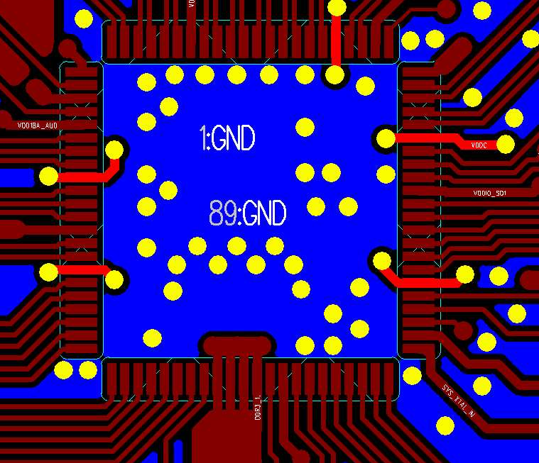
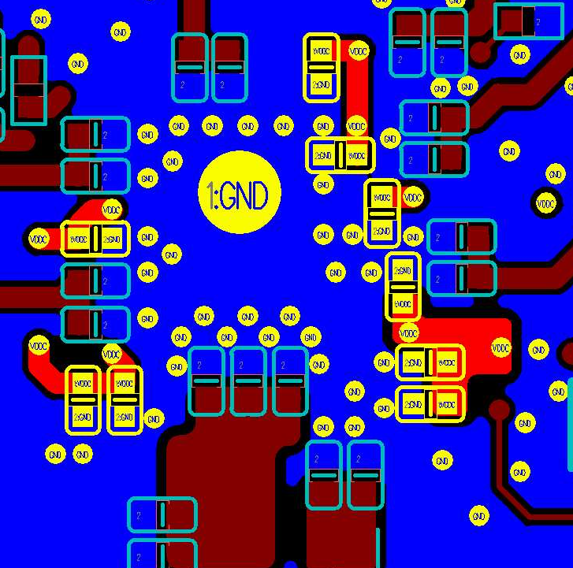
QFN – 4L/6L-PCB – VDDC – Rule 1
Power | Layer | SOC VIA count | DeCap | Layout Rule
VDDC | Top/Bottom | 10 | (1) 0402 0.1uF: C1/C2/C6/C8/ (2) 0402 1uF: C3/C4/C9 (3) 0402 4.7uF: C5/C7 | VDDC VIA rule 1) Each VDDC pin needs to be connected to two vias 2) Confirm that there is at least 1 VDDC via next to each Cap (2) GND VIA rule Confirm that there is at least one GND via next to each Cap
VDDC@Top
VDDC@Bottom
C7
C8
SOC
C9
C6
C1
C2
C5
C4
C3

Slide 48
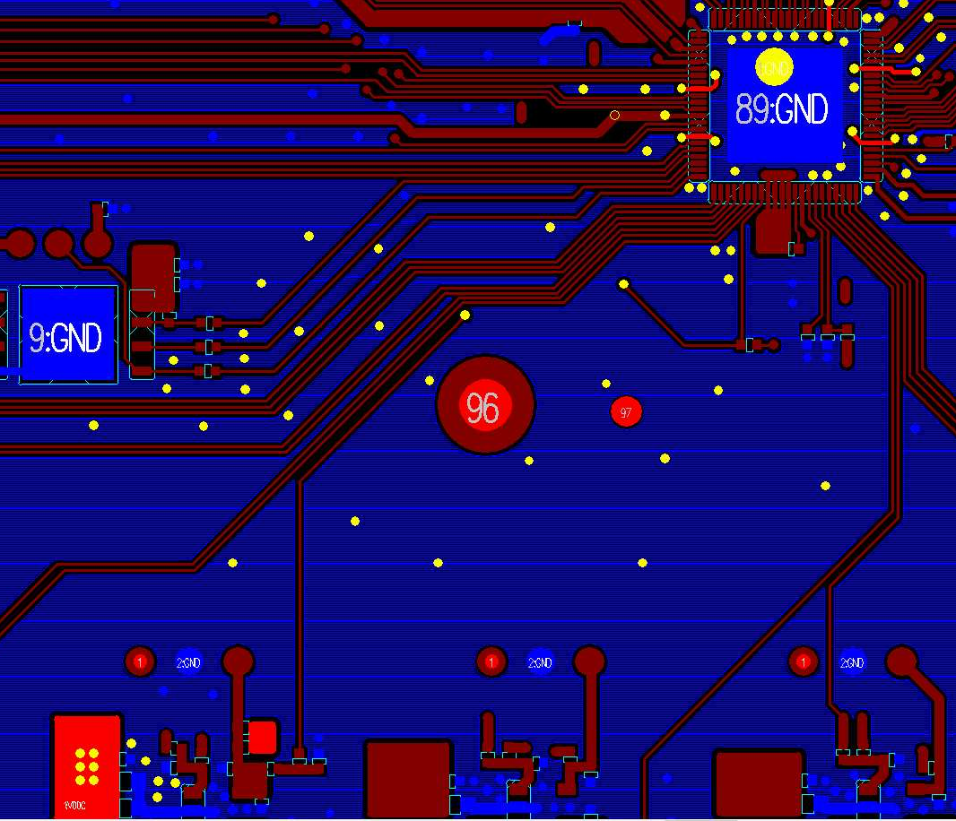
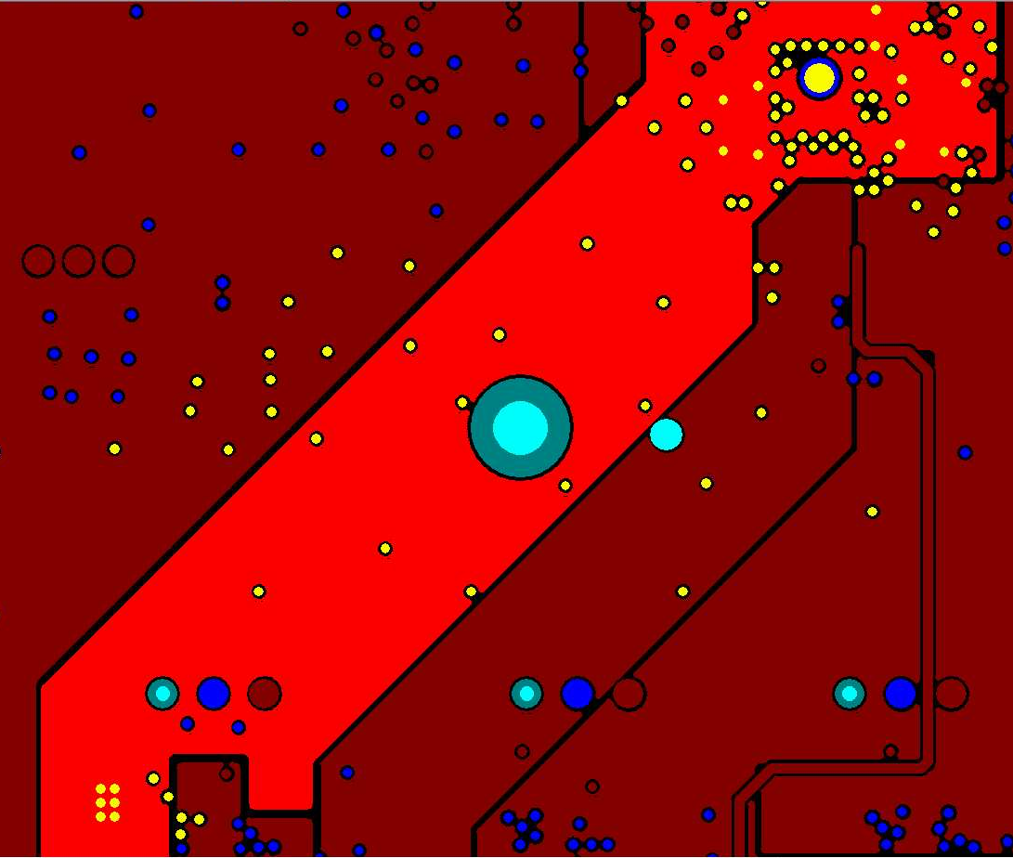
QFN – 4L/6L-PCB – VDDC – Rule 2
Power | Layer | Layout Rule
VDDC | VDDC main routing, 4L-PCB: DDR3_1.5V@L3 6L-PCB: DDR3_1.5V@L4 | DDR3_1.5V inner layer winding : (1) Confirm 10 vias at SOC and 6 vias at PMIC (2) Effective width deduction of vias in the SOC area: W1>=4mm (below SOC QFN), W2>=1.5mm (entering SOC area ) (3) Effective width deduction of vias in the PMIC area: W3>=1.5mm (4) Main route effective width deduction for vias: W4>=1.5mm
4L-PCB: VDDC@L3
6L-PCB: VDDC@L4
VDDC@Top
SOC
W1
W2
10 vias at SOC
SOC area
W4
PMIC area
PMIC
W3
6 vias at PMIC

Slide 49
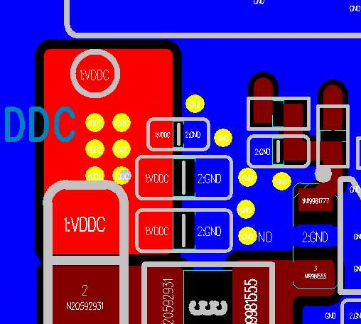
QFN – 4L/6L-PCB – VDDC – Rule 3
Power | PMIC Branch Node VIA Quantity
VDDC | (1) VDDC: VIA quantity >=6 (2) GND: VIA quantity>=5
VDDC@Top
PMIC routing area
PMIC Branch Node VIA Quantity
VDDC:
VIA quantity: 6
GND:
VIA quantity: 6
PMIC

Slide 50
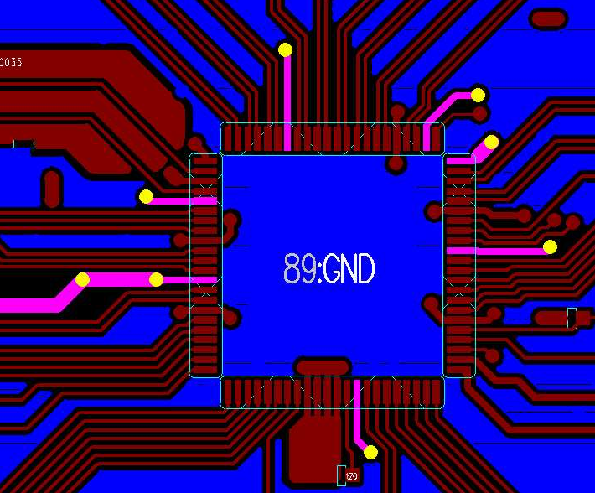
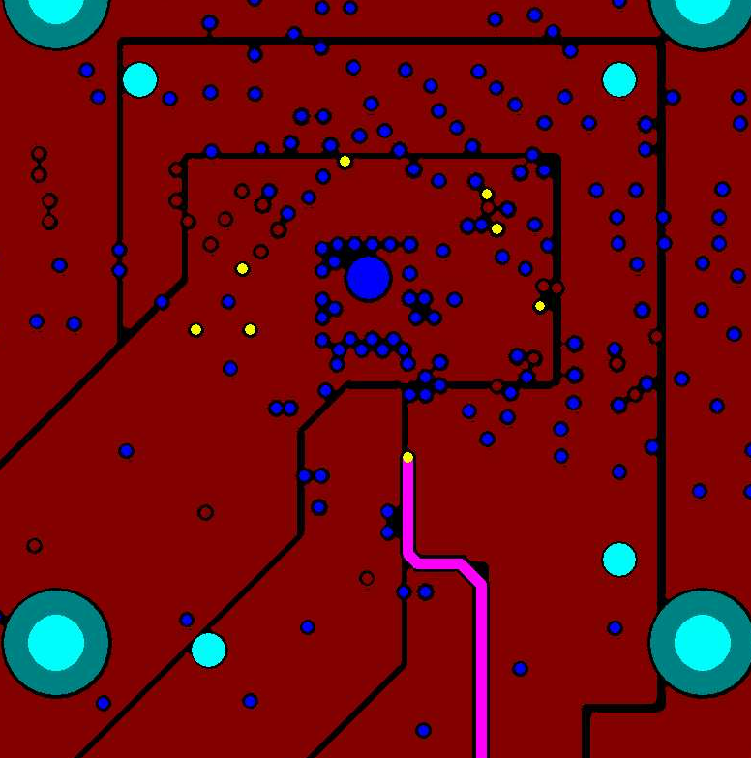
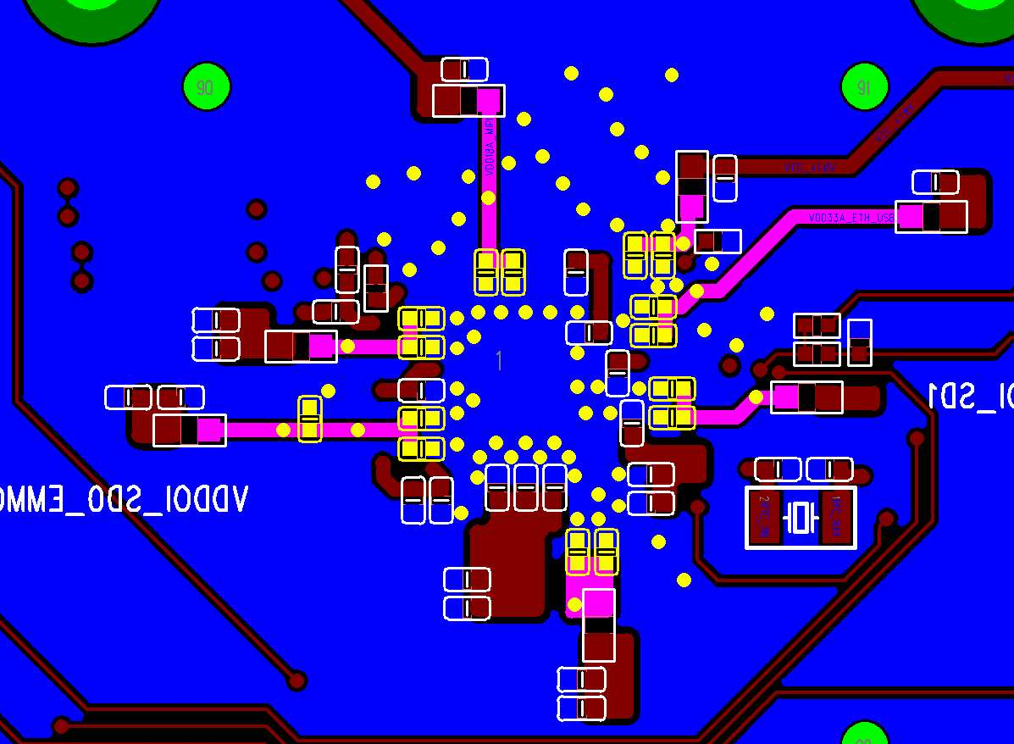
QFN – 4L/6L-PCB – Analog IO Power – Rule 1
Power | Layer | Layout Rule
VDD18A_AUD/VDD_18A_MIPI VDD18A_USB_PLL_ETH VDD33A_EPH_USB VDDIO_RTC VDDIO_SD0_A/VDDIO_SD1 | 4L-PCB: Top/Bottom/L3 6L-PCB: Top/Bottom/L4 | @Top: (1) Break out (fan-out):trace width W1>=0.25mm (2) Main route:trace width W2>=0.5mm @Inner layer : All trace width W3>=0.5mm @Bottom:All trace width W4>=0.5mm
Analog IO power@Top
Analog IO power@Inner
Analog IO power@Bottom
SOC
SOC
W4
W1
W1
W3
W2

Slide 51
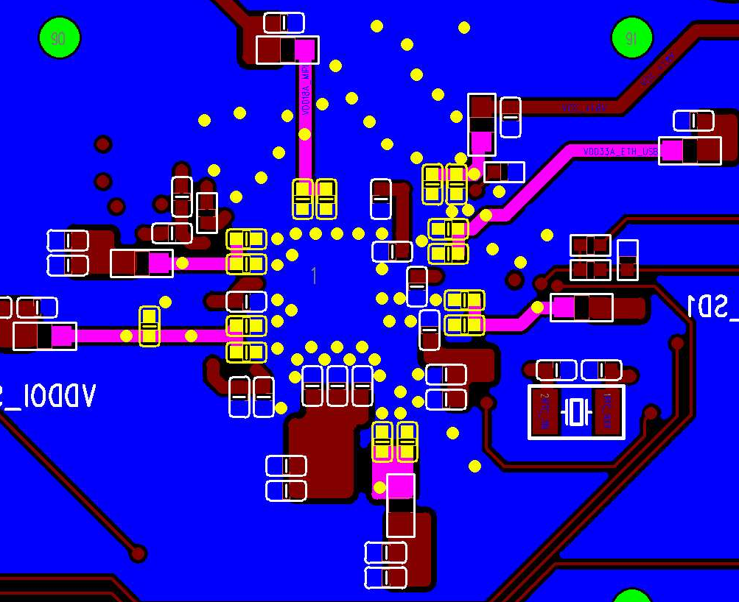
QFN – 4L/6L-PCB – Analog IO Power – Rule 2
Power | Layer | Layout Rule
VDD18A_AUD/VDD_18A_MIPI VDD18A_USB_PLL_ETH VDD33A_EPH_USB VDDIO_RTC VDDIO_SD0_A/VDDIO_SD1 | Top/Bottom | (1) Analog IO power VIA rule Confirm that there is at least 1 analog IO power via next to each Cap (2) GND VIA rule Confirm that there is at least 1 GND via next to each Cap
Analog IO power@Top
Analog IO power@Bottom
SOC

Slide 52
Analog / Digital Power Supply Winding
BGA PKG: SG2000
4-layer/6-layer PCB

Slide 53
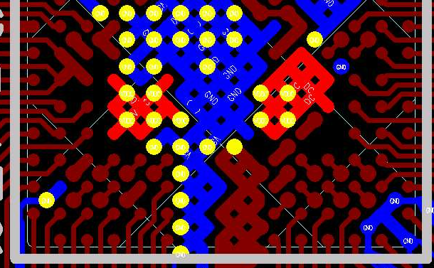

BGA – 4L/6L-PCB – VDDC – Rule 1
Power | Layer | SOC VIA Count | DeCap | Layout Rule
VDDC | Top/Bottom | 9 | (1) 0402 0.1uF: C1 (2) 0402 1uF: C3/C4/C5 (3) 0402 4.7uF: C2 | VDDC VIA rule Confirm that the VDDC via is closely connected to the CAP GND VIA rule Confirm that the GND via is closely connected to CAP
VDDC@Top
VDDC@Bottom
C4
SOC
C1
C2
C3
C5

Slide 54


BGA – 4L/6L-PCB – VDDC – Rule 2
Power | Layer | Layout Rule
VDDC | VDDC main routing, 4L-PCB: DDR3_1.5V@L3 6L-PCB: DDR3_1.5V@L4 | DDR3_1.5V inner layer winding ; (1) Confirm 9 vias at SOC and 6 vias at PMIC (2) Effective width deduction of vias in the SOC area: W1>=1mm (below the SOC ball), W2>=1.5mm (entering SOC area ) (3) Effective width deduction of vias in the PMIC area: W3>=1.5mm (4) Main route, effective width deduction for vias: : W4>=1.5mm
4L-PCB: DDR3_1.5V@L3
6L-PCB: DDR3_1.5V@L4
DDR3_1.5V@Top
SOC
SOC area
W1
W2
9 vias at SOC
W4
PMIC area
W3
PMIC
6 vias at PMIC

Slide 55


BGA – 4L/6L-PCB – VDDC – Rule 3
Power | PMIC Branch Node VIA Quantity
VDDC | (1) VDDC: VIA quantity>=6 (2) GND: VIA quantity>=5
DDR3_1.5V@Top
PMIC routing area
PMIC Branch Node VIA Quantity
VDDC:
VIA quantity: 6
GND:
VIA quantity: 5
PMIC

Slide 56



BGA – 4L/6L-PCB – Analog IO Power – Rule 1
Power | Layer | Layout Rule
VDDIO_18A/VDDIO18_1 VDD18A_AUD/VDD18A_ETH/VDD_18A_MIPI VDD18A_PLL_N/VDD18A_USB VDD33A_EPHY/VDD33A_ETH VDDIO_EMMC/VDDIO_RTC/VDDIO_VIVO VDDIO_SD0/VDDIO_SD0_A/VDDIO_SD1 VDD09A_EPHY/VDD09A_MIPI VIN3V | 4L-PCB: Top/Bottom/L3 6L-PCB: Top/Bottom/L4 | @Top: trace width W1>=0.3mm (the shortest distance between ball and VIA ) @Inner layer: (1) SOC ball area: trace width W2>=0.3mm (2) Area outside SOC ball : trace width W3>0.5mm @Bottom: (1) SOC ball area: trace width W4>=0.3mm (2) Area outside SOC ball : trace width W5>0.5mm
Analog IO power@Top
Analog IO power@Inner
Analog IO power@Bottom
SOC
SOC
SOC
W1
W3
W2
SOC ball area
W5
SOC ball area
Area outside SOC ball
W4
Area outside SOC ball

Slide 57


BGA – 4L/6L-PCB – Analog IO Power – Rule 2
Power | Layer | Layout Rule
VDDIO_18A/VDDIO18_1 VDD18A_AUD/VDD18A_ETH/VDD_18A_MIPI VDD18A_PLL_N/VDD18A_USB VDD33A_EPHY/VDD33A_ETH VDDIO_EMMC/VDDIO_RTC/VDDIO_VIVO VDDIO_SD0/VDDIO_SD0_A/VDDIO_SD1 VDD09A_EPHY/VDD09A_MIPI VIN3V | Top/Bottom | (1) Analog IO power VIA rule Confirm that there is at least 1 analog IO power via next to each Cap (2) GND VIA rule Confirm that there is at least 1 GND via next to each Cap
Analog IO power@Top
Analog IO power@Bottom
SOC

Slide 58
Appendix

Slide 59
MIPI/EPHY/USB/Antenna Impedance Control
4-layer PCB

Slide 60
MIPI/EPHY/USB Impedance Control – Surface Layer Routing Option1
Layer | Target Z (ohm) | W (mils) | S (mils) | D (mils) | Estimated Z (ohm)
Top/Bottom | 100 | 5 | 5 | 6 | 97.99
 | 90 | 5 | 4 | 6 | 92.48
MIPI/USB differential signals are required impedance control - Target impedance: (1) MIPI- CSI/DSI: 100ohm (2)USB: 90ohm
Differential signals shielding rule:
- pair to pair GND shielding
D
W
S
W
D
G
P
N
G
pp
GND

Slide 61


MIPI/EPHY/USB Impedance Control – Surface Layer Routing Option1
Target Z (ohm) | W (mils) | S (mils) | D (mils) | Estimated Z (ohm)
100 +/- 5% | 5 | 5 | 6 | 97.99
Target Z | W (mils) | S (mils) | D (mils) | Estimated Z (ohm)
90 +/- 5% | 5 | 4 | 6 | 92.48

Slide 62
MIPI Impedance Control – Surface Layer Routing Option2
Layer | Target Z (ohm) | W (mils) | S (mils) | Ds (mils) | Dg (mils) | Estimated Z (ohm) | Rule
Top/Bottom | 100 | 5 | 5 | 12 | 12 | 99.96 | Ds=3W, Dg=3W
G
P
N
P
N
G
pp
Dg
W
S
W
Ds
W
S
W
Dg
GND

Slide 63



MIPI Impedance Control – Surface Layer Routing Option2
Target Z (ohm) | W (mils) | S (mils) | Ds (mils) | Dg (mils) | Estimated Z (ohm)
100 +/- 5% | 5 | 5 | 12 | 12 | 99.96
 | 4 | 4 | 12 | 12 | 101.21

Slide 64
MIPI Impedance Control – Inner Layer Routing
Layer | Target Z (ohm) | W (mils) | S (mils) | Ds (mils) | Dg (mils) | Estimated Z (ohm)
L2/L3 | 100 | 5 | 10 | 12 | 12 | 98.93
GND
pp
G
P
N
P
N
G
Dg
W
S
W
Ds
W
S
W
Dg
Core
GND

Slide 65



MIPI Impedance Control – Inner Layer Routing
Target Z (ohm) | W (mils) | S (mils) | Ds (mils) | Dg (mils) | Estimated Z (ohm)
100 +/- 5% | 5 | 10 | 12 | 12 | 98.93
 | 4 | 7 | 12 | 12 | 100.18

Slide 66
EPHY/USB Impedance Control – Inner Layer Routing
Layer | Target Z (ohm) | W (mils) | S (mils) | D (mils) | Estimated Z (ohm)
L2/L3 | 100 | 5 | 10 | 12 | 98.92
 | 90 | 5 | 7 | 6 | 90.33
GND
D
W
S
W
D
pp
G
P
N
G
Core
GND

Slide 67




EPHY/USB Impedance Control – Inner Layer Routing
Target Z (ohm) | W (mils) | S (mils) | D (mils) | Estimated Z (ohm)
100 +/- 5% | 5 | 10 | 12 | 98.92
 | 4 | 7 | 8 | 99.11
Target Z (ohm) | W (mils) | S (mils) | D (mils) | Estimated Z (ohm)
90 +/- 5% | 5 | 7 | 6 | 90.33
 | 4 | 5 | 6 | 90.34

Slide 68
Antenna 50ohm Impedance Control
Layer | Target Z (ohm) | W (mils) | D1 (mils) | D2(mils) | Estimated Z (ohm) | Note
Top | 50 | 30 | 6 | 12 | 50.93 | Ref layer L4
Layer - Top
D1
W
D1
L1
G
Sig
G
pp
L2
GND
D2
D2
GND
Core
L3
GND
PWR
PWR
pp
L4
GND

Slide 69

Antenna 50ohm Impedance Control
Target Z (ohm) | W (mils) | D1 (mils) | D2(mils) | Estimated Z (ohm)
50 +/- 5% | 30 | 6 | 12 | 50.93
D1
W
D1
L1
G
Sig
G
pp
L2
GND
D2
D2
GND
Core
L3
GND
PWR
PWR
pp
L4
GND

Slide 70
MIPI/EPHY/USB/Antenna Impedance Control
True 6 layer, 6-layer PCB

Slide 71
MIPI/EPHY/USB Impedance Control – Surface Layer Routing Option1
Layer | Target Z (ohm) | W (mils) | S (mils) | D (mils) | Estimated Z (ohm)
Top/Bottom | 100 | 5 | 5 | 6 | 97.99
 | 90 | 5 | 4 | 6 | 92.48
MIPI/USB differential signals are required impedance control - Target impedance: (1) MIPI- CSI/DSI: 100ohm (2)USB: 90ohm
Differential signals shielding rule:
- pair to pair GND shielding
D
W
S
W
D
G
P
N
G
pp
GND

Slide 72
MIPI/EPHY/USB Impedance Control – Surface Layer Routing Option1
Target Z (ohm) | W (mils) | S (mils) | D (mils) | Estimated Z (ohm)
100 +/- 5% | 5 | 5 | 6 | 97.99
Target Z | W (mils) | S (mils) | D (mils) | Estimated Z (ohm)
90 +/- 5% | 5 | 4 | 6 | 92.48

Slide 73
MIPI Impedance Control – Surface Layer Routing Option2
Layer | Target Z (ohm) | W (mils) | S (mils) | Ds (mils) | Dg (mils) | Estimated Z (ohm) | Rule
Top/Bottom | 100 | 5 | 5 | 12 | 12 | 99.96 | Ds=3W, Dg=3W
G
P
N
P
N
G
pp
Dg
W
S
W
Ds
W
S
W
Dg
GND

Slide 74
MIPI Impedance Control – Surface Layer Routing Option2
Target Z (ohm) | W (mils) | S (mils) | Ds (mils) | Dg (mils) | Estimated Z (ohm)
100 +/- 5% | 5 | 5 | 12 | 12 | 99.96
 | 4 | 4 | 12 | 12 | 101.21

Slide 75
MIPI Impedance Control – Inner Layer Routing
Layer | Target Z (ohm) | W (mils) | S (mils) | Ds (mils) | Dg (mils) | Estimated Z (ohm)
L2/L3 | 100 | 5 | 10 | 12 | 12 | 98.44
GND
pp
G
P
N
P
N
G
Dg
W
S
W
Ds
W
S
W
Dg
Core
GND

Slide 76


MIPI Impedance Control – Inner Layer Routing
Target Z (ohm) | W (mils) | S (mils) | Ds (mils) | Dg (mils) | Estimated Z (ohm)
100 +/- 5% | 5 | 10 | 12 | 12 | 98.44
 | 4 | 7 | 12 | 12 | 99.92

Slide 77
EPHY/USB Impedance Control – Inner Layer Routing
Layer | Target Z (ohm) | W (mils) | S (mils) | D (mils) | Estimated Z (ohm)
L2/L3 | 100 | 5 | 10 | 12 | 98.44
 | 90 | 5 | 7 | 6 | 90.14
GND
D
W
S
W
D
pp
G
P
N
G
Core
GND

Slide 78




EPHY/USB Impedance Control – Inner Layer Routing
Target Z (ohm) | W (mils) | S (mils) | D (mils) | Estimated Z (ohm)
100 +/- 5% | 5 | 10 | 12 | 98.44
 | 4 | 7 | 8 | 98.92
Target Z (ohm) | W (mils) | S (mils) | D (mils) | Estimated Z (ohm)
90 +/- 5% | 5 | 7 | 6 | 90.14
 | 4 | 5 | 6 | 90.24

Slide 79
Antenna 50ohm Impedance Control
Layer | Target Z (ohm) | W (mils) | D1 (mils) | D2(mils) | Estimated Z (ohm) | Note
Top | 50 | 30 | 6 | 12 | 50.55 | Ref layer L5
Layer - Top
D1
W
D1
L1
G
Sig
G
pp
D2
D2
L2
GND
GND
Core
L3
GND
GND
pp
PWR
PWR
L4
GND
Core
L5
GND

Slide 80

Antenna 50ohm Impedance Control
Target Z (ohm) | W (mils) | D1 (mils) | D2(mils) | Estimated Z (ohm)
50 +/- 5% | 30 | 6 | 12 | 50.55
D1
W
D1
L1
G
Sig
G
pp
D2
D2
L2
GND
GND
Core
L3
GND
GND
pp
PWR
PWR
L4
GND
Core
L5
GND

